Slide 1
Decathlon case study

Slide 2
Purpose of the Presentation
The primary objective of this presentation is to thoroughly analyze the provided data and derive actionable insights that will directly benefit our company. By examining the data, we aim to identify strategic opportunities, address challenges, and recommend effective measures for enhancing overall performance and achieving organizational goals.

Slide 3
Data Cleaning, Analysis, and Visualization
I undertook a comprehensive data analysis process, combining SQL Server Management Studio (SSMS) and Tableau, to extract valuable insights from the dataset. Here’s how we approached it:
Data Cleaning and analyzing with SSMS:
Leveraging window functions (e.g., ROW_NUMBER and aggregate functions (e.g., SUM, COUNT), I meticulously cleaned and analyzed the dataset .
Removed duplicate data, converted the data type of columns and ensured data integrity.
Utilizing SQL queries, I explored patterns, trends, and relationships within the data.
Aggregated sales, customer segments, and other relevant metrics.
Derived actionable insights to guide decision-making.
Tableau Visualization:
To enhance data representation, I created intuitive visualizations in Tableau.
My interactive dashboards provide a clear overview of sales performance, customer behavior, and product insights.
Stakeholders can easily grasp key takeaways and explore details.

Slide 4
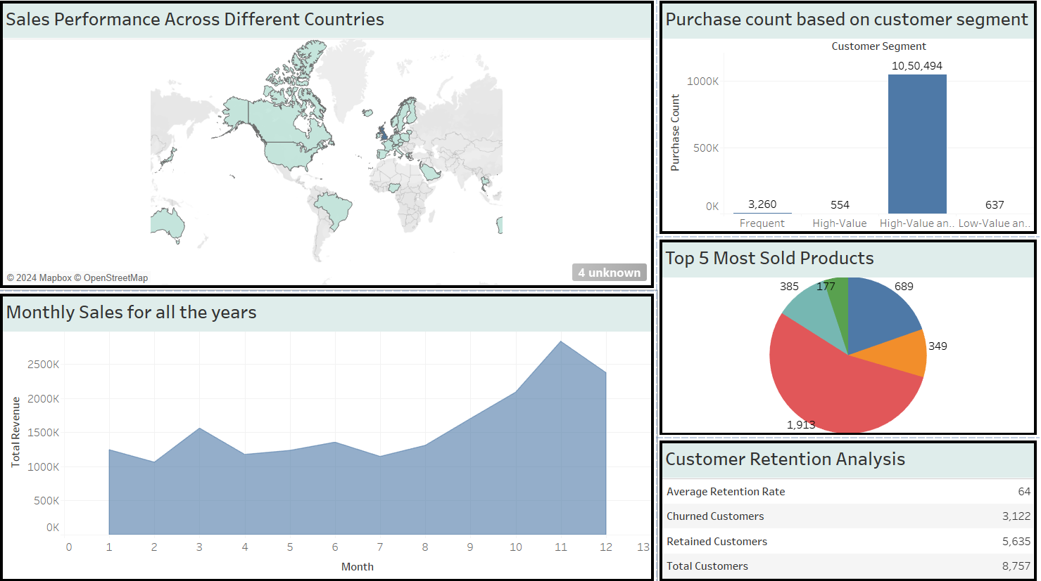
DATA VISUALIZATION USING TABLEAU

Slide 5
Key observations
Sales Performance Across Different Countries:
The world map highlights sales performance across various countries.
Darker shades indicate higher sales, while lighter or unshaded areas represent lower or no sales.
Notable observations:
Sales are concentrated in specific regions (e.g., North America, Western Europe).
Some countries have minimal or no sales data (e.g., parts of Africa, Central Asia).
Monthly Sales Trends:
The line graph shows monthly sales over the course of a year.
Key observations:
Sales exhibit a consistent upward trend throughout the year.
There’s a significant surge in sales around the 11th month (October or November).
This seasonality could be due to holidays, promotions, or other factors.

Slide 6
Customer Segments:
The bar graph displays purchase counts based on customer segments.
Noteworthy points:
The “Frequent” customer segment has the highest purchase count.
“Low-Value on Air” customers also contribute significantly.
High-value segments (e.g., “High-Value,” “High-Value on Air”) have comparatively lower purchase counts.
Top 5 Most Sold Products:
The pie chart reveals the distribution of sales among the top 5 products.
Observations:
50’s Christmas gift bag large dominates sales (the red section).
Other products have relatively smaller shares.
Customer Retention Analysis:
The textual information provides key metrics:
Average retention rate: 64%
Churned customers: 3,122
Retained customers: 5,635
Total customers: 8,757

Slide 7

Recommendations to Ceo

Slide 8
Expand Market Reach:
Target countries with low sales.
Explore new markets and establish partnerships.
Invest in localized marketing efforts.
Optimize Year-End Strategies:
Leverage the year-end sales trend.
Plan promotions, discounts, or product launches accordingly.
Segment-Specific Marketing:
Tailor marketing campaigns to different customer segments.
Retain high-value customers and engage low-value frequent customers.

Slide 9
Problem
Market gap: few, if any, products on the market help customers like we do
Customers: 66% of US consumers spend money on multiple products that only partially resolves their issue
Financials: millennials account for about a quarter of the $48 billion spent on other products in 2018
Costs: loss of productivity costing consumers thousands of dollars
Usability: customers want something easy to use that helps make their life easier

Slide 10

Thank you
Bhavesh Ahuja D

